Slide 1
TRNs
How to Build Community Support
1/10/24

Slide 2
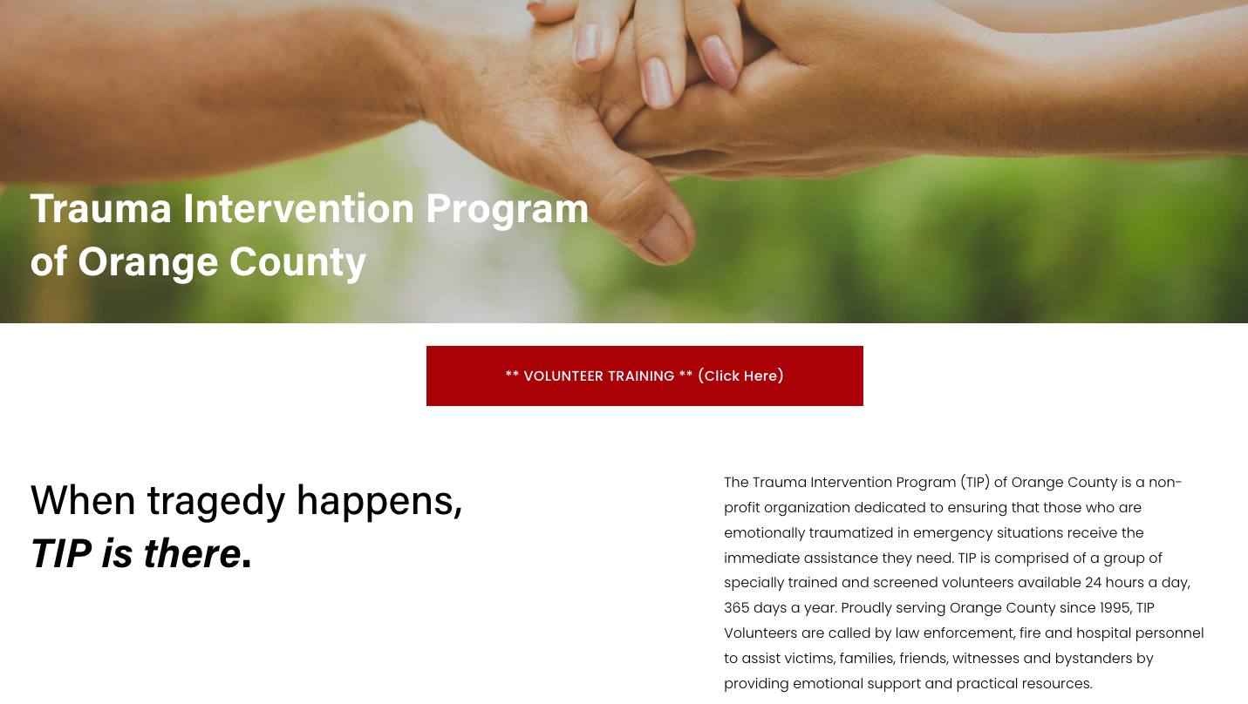
Identify One Crisis Response Team

Slide 3
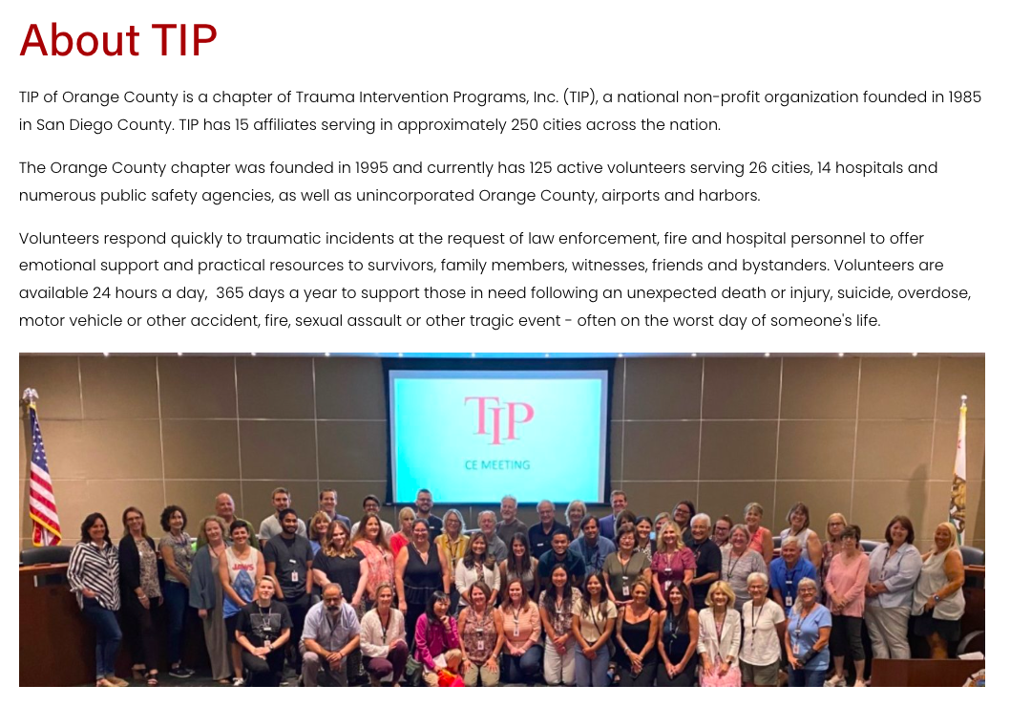

Slide 4
Other Crisis Organizations in the Community
Victims of crime programs/District Attorney’s Office
  Waymakers
Dept of Education Crisis Teams
  Crisis Response Network of Orange County (CRN)
Psychological support system for Law Enforcement & Fire Dept.
County Mental Health Disaster Team
FBI & Red Cross (less important)

Slide 5
Build the Relationship
Educate them on EMDR
See their referrals or help connect their referrals to EMDR clinicians
Offer them some pro bono/paid sessions

Slide 6
Birth of Orange County TRN
2017 Las Vegas Shooting
Coordination of some of the connections already made & new ones
  TIP & Mother of one of the victims
  Sheriff’s dept. Psychologist
Many EMDR clinicians volunteered
2018 the OC TRN was formed.

Slide 7
Maintain Relationships
Stay Connected through emails, texts, calls
Plan to do presentations and educate
Set up meetings and connections with the prominent groups in the community, so that everyone is working together.

Slide 8
Build a Network of EMDR Clinicians
Find or start consultation groups
Connect with EMDR Consultants and trainers in your area
See if they’ll share their email lists
Search EMDRIA/Psychology Today and reach out
Train them in RTEP/GTEP and let them practice!

Slide 9
OC TRN Redefined after Covid
OC TRN
  Clinicians became overwhelmed with Covid
  Tip referrals increased, and we couldn’t meet demand
  Limitations with telehealth
Surveyed the TRN clinicians and changed our criteria
  All first responders, including TIP volunteers
  Any victim of a mass event
What happened to TIP?

Slide 10
Community Outreach Coordinator
Identify a clinician on the TRN who is willing and would be good at building relationships in the community.
Personality, experience, and willingness

Slide 11

Cook’s Corner

